Slide 1

Spirit
It’s more than just pom-poms
Massive Mini Workshop 2009
Liberty Senior High School, MO
Presented by Ann Fairburn
Team #1939 The Kuh-Nig-Its at the Barstow School
Winner 2006 Daimler/Chrysler Team Spirit Award – St. Louis
2009 Chrysler Team Spirit Award – Kansas City

Slide 2
Possible Awards
Chrysler Team Spirit - This award celebrates extraordinary enthusiasm and spirit through exceptional partnership and teamwork.
Imagery- This award celebrates attractiveness in engineering and outstanding visual aesthetic integration from the machine to team appearance.

Slide 3
Many people think spirit is :
Busy work
That thing the girls do while the guys build
Something we do only if we get around to it
Not something that will help our team.
Not something a serious robotics team needs to do

Slide 4
What it really is
The Marketing Arm
Often Overlooked
Allows the engineering team to function
Makes the team memorable and recognizable from year to year
A easy entrance into science and engineering for that kid who doesn’t think they know enough to build a robot.
Responsible for the team “brand”

Slide 5
Think of spirit as marketing
In a company, no matter how great your “product” is, if nobody has heard about it, nobody will buy it.
Your image is how every team will think of you and recognize you year after year.
You are trying to establish a “reputation” with a visual hook.

Slide 6
Gracious professionalism
The one thing that sets us apart from other competitions is our ethos of Gracious Professionalism.
That means we don’t only cheer for our own team, we also cheer for the other teams as well.
When any team does an awesome job, it means they have added to the overall level of the competition which helps all of us. So they deserve our applause and cheers.

Slide 7


Just as Coke and Pepsi compete for your attention
vs

Slide 8
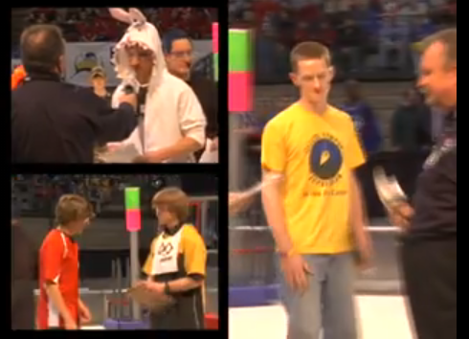
We are all trying to attract attention for that final alliance pick

Slide 9
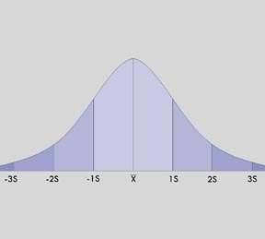
Most of our robots will be average- not obviously great not absolutely horrible
Most of us are around here
| |
V V
Lousy Robot
Great Robot

Slide 10
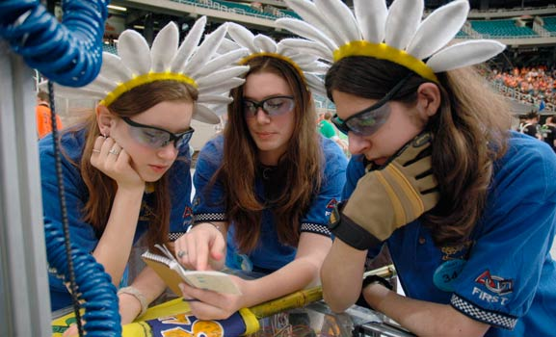
Teams have 15 minutes to make a final alliance pick.
Teams won’t remember your school name
Teams won’t remember your team number
They will remember Miss Daisy, the Pink team, or the Bomb Squad and figure out your number from that.

Slide 11
In the Beginning…

Slide 12
Rules
Make it safe
Can’t be too distracting or obnoxious
No noisemakers or food.
No music on your cart
Mascots must be escorted if they cannot see clearly.
Don’t make it rude, crude and socially unacceptable (not too much at least)

Slide 13
First - pick a name/theme
Make it unique (check it out here http://www.firstwiki.net/index.php/Index_of_Teams to make sure it hasn’t been taken)
You can play off your school’s mascot
Knights -> Kuh-Nig-Its, Mustangs – Metal Mustangs
Your Sponsors – Space Cookies, Exploding Bacon
Your number – 1776 colonial theme.
Or an acronym – MOE, SWAT, STAG
It doesn’t have to be “robot” related. Don’t be afraid to be silly – Pink, Landsharks, Killer bees
Check it out with School Administration and be ready to defend with examples if they want you to be Joe Smith High School Robotics

Slide 14
Name Examples
Duct Tape Bandits
The Cat Attack
Cobra Commanders
Surgeons of Steel
RoboDawgs
SPARK - Students Pursuing Applied Robotics Knowledge
Skunkworks Robotics

Slide 15
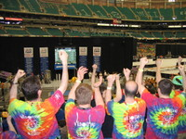
Second – pick colors
At least 2 strong dominant visible colors that you can get fabric and T- shirts in.
School colors may be required
Most kids want black t-shirts, however they can make you blend in with the crowd in the arena.

Slide 16
Third – make a logo with number
Make them simple so that they can be easily replicated.
Don’t use shading or gradients
Make them uncluttered so that they can be recognized from 10 feet away
Get it in Layers in Photoshop
Don’t change it. That is your brand
Put it on everything

Slide 17


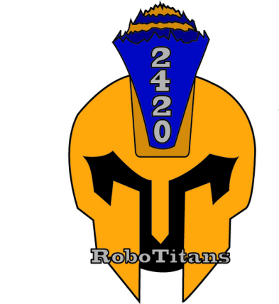




Not too busy
Get it in photo shop, preferably vectorized drawing

Slide 18













All of these logos are simple and uncluttered. Easy to replicate and recognize.

Slide 19




It doesn’t always work the first year
2007
2006
2009..
2008

Slide 20
Fourth - Design your Shirt
Include team number, name, logo
Use your colors
Make it stand out from across the room. Black doesn’t
Make sure the font is large enough to be legible.
Should cost about $10-$15 /shirt for 4 color
Put FIRST logo on sleeve. Logo at First website under Communications Resource center. http://www.usfirst.org/roboticsprograms/resourcecenter.aspx?id=650
Include sponsors

Slide 21
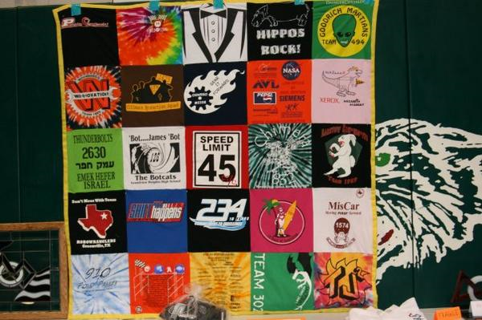
Quilt made of t-shirts

Slide 22
Fifth – develop flair
Keep them cheap and safe
Make a lot of them
Relate them to your theme
You MUST have buttons at the very least 500 – 1000 per regional buy a button maker at Dr. Don’s http://www.buttonsonline.com/machines.html
If you want to do a team giveaway, go out and get donations. Pink team gave a sand pail and shovel, sunglasses, BIG bottle of sun tan lotion and a bag of Florida sand.
Check out US Toy or Oriental Trading Company.
Oriental Trading Company - http://www.orientaltrading.com
US Toy – in town at 435 and StateLine http://www.orientaltrading.com

Slide 23

Remember to Sell your number
Connect your team number to your team
Make sure it is in large font on your shirt
Put it on all flair
Put it on your pit banners
Put it in your logo

Slide 24
Extras

Slide 25
Develop a cheer or dance
Here are the pom-poms if you want them.
Invite the dance team to help.
Teach everyone the song/dance/cheer.
Do it together (a lot)….
http://moe365.org/sounds.php
http://video.google.com/videoplay?docid=-1467985459933878239&hl=en#

Slide 26
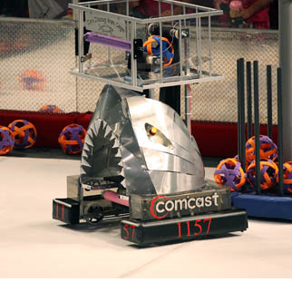
Robot
Try to make the robot reflect your theme.
Easiest is color of the
bumpers
Best is the robot itself.
Landsharks shark robot

Slide 27
Develop a robot “trading card”
Develop a handout that lists all the “selling” points about your robot.
How fast does it go, how many balls does it hold, what kind of drive does it have?
Include a picture, team number, name and logo
Pass it out to the scouting teams, pass it out again on Saturday morning.
Have the kids who were less involved in the building interview the builders to figure out what makes the robot awesome.

Slide 28
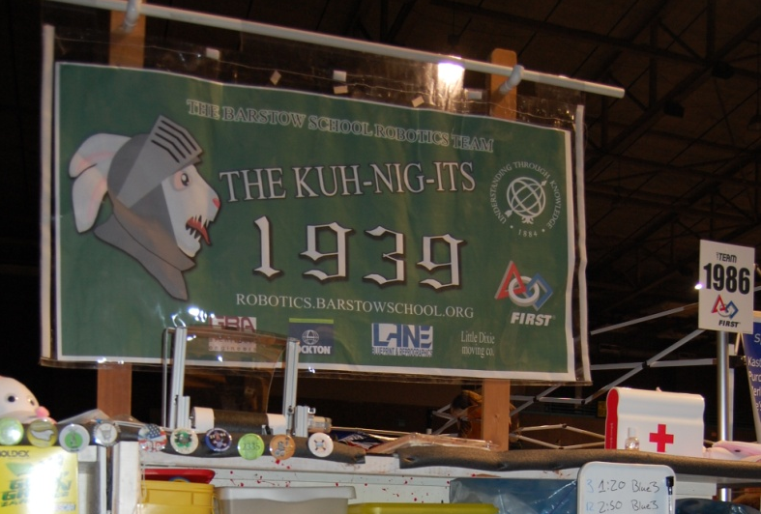
Banners
Do not make them specific to the year or game unless you have money to burn.
Put the sponsors on velcro so you can change them out if they don’t continue sponsoring.
We print a 2 foot paper banner in the back of the pit inside a plastic pocket
Display in pit.

Slide 29
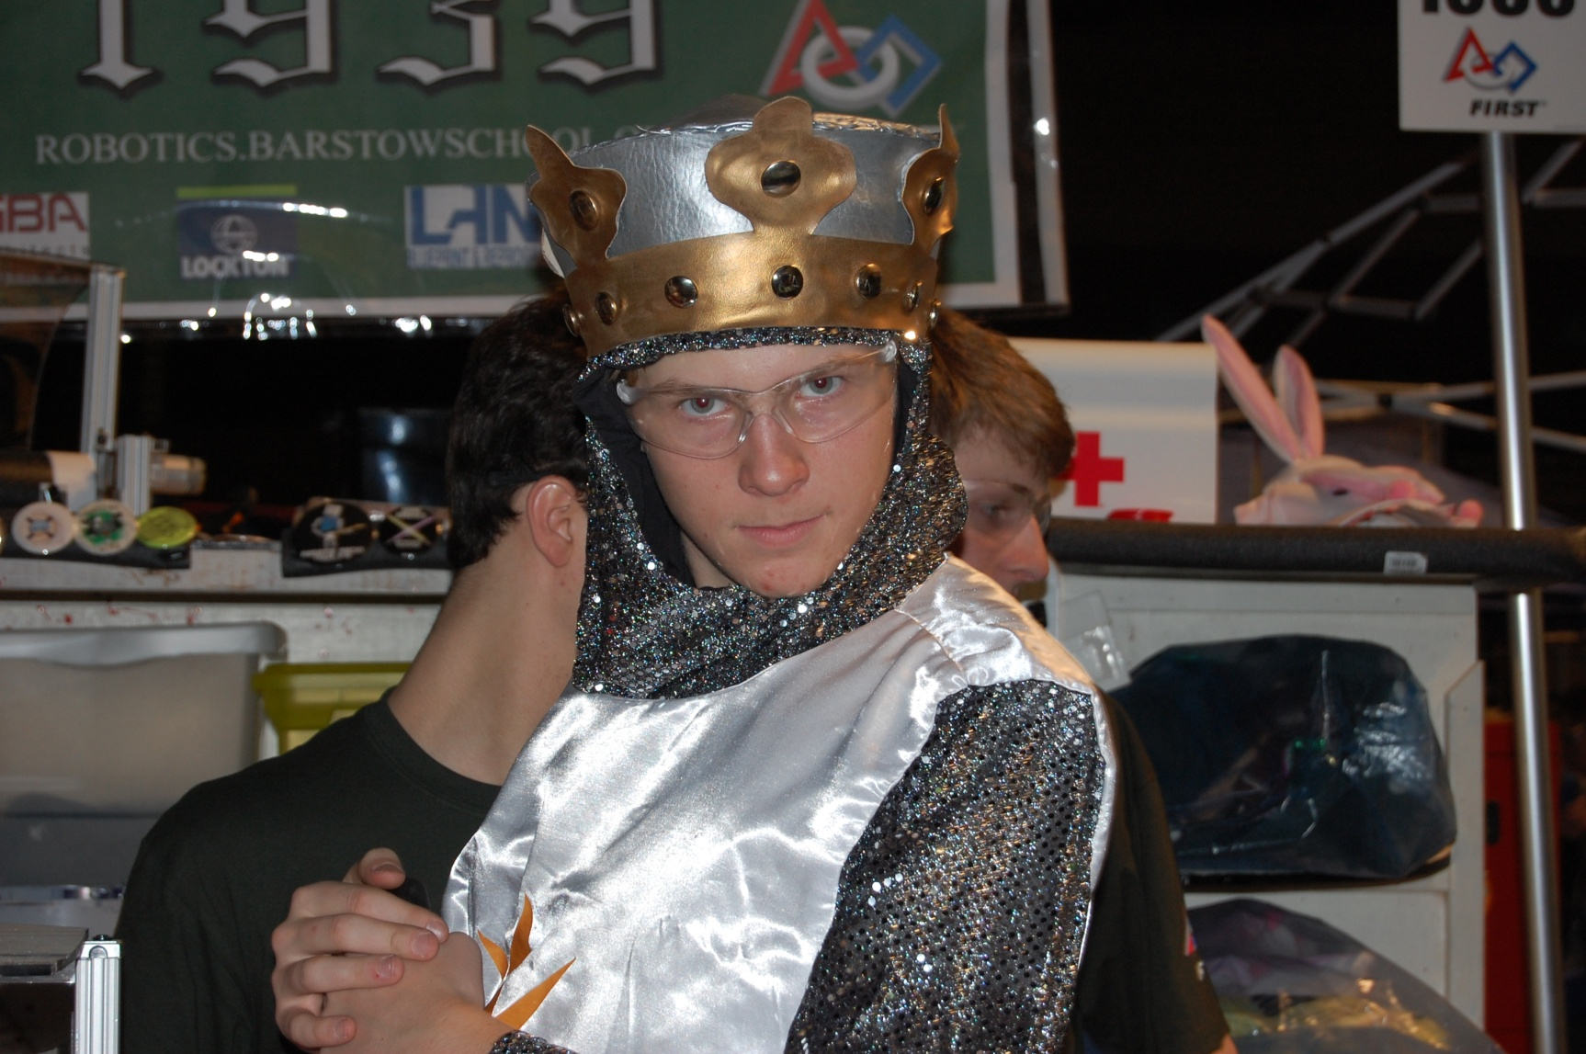
Develop a mascot

Slide 30
There are a lot of opportunities at the regionals for the mascot. Many regionals will have all the mascots gather and dance.
They are great for interacting with young children who are touring the pits.
Many teams borrow the school mascot. Warning: they are hot, heavy, and hard to see out of. This type must be escorted in the pits for safety reasons.
Make sure that you can clean it easily.

Slide 31
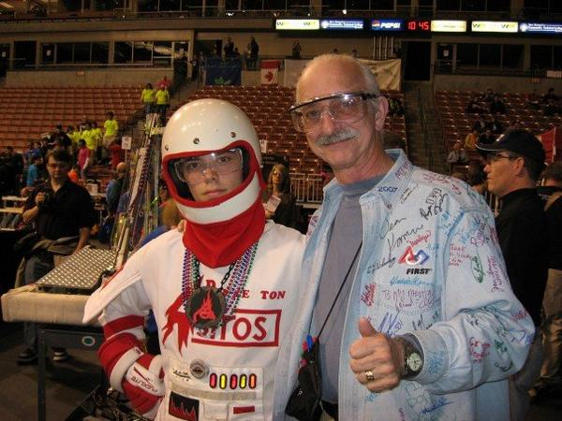
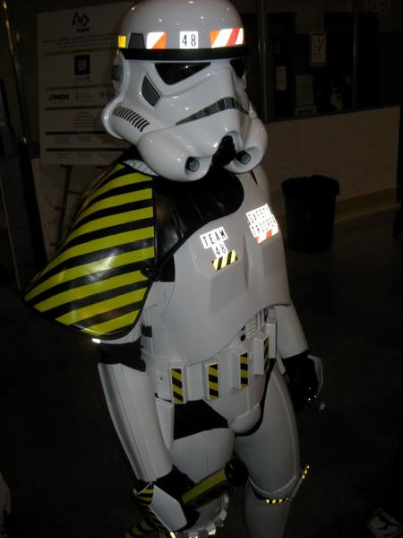

Slide 32
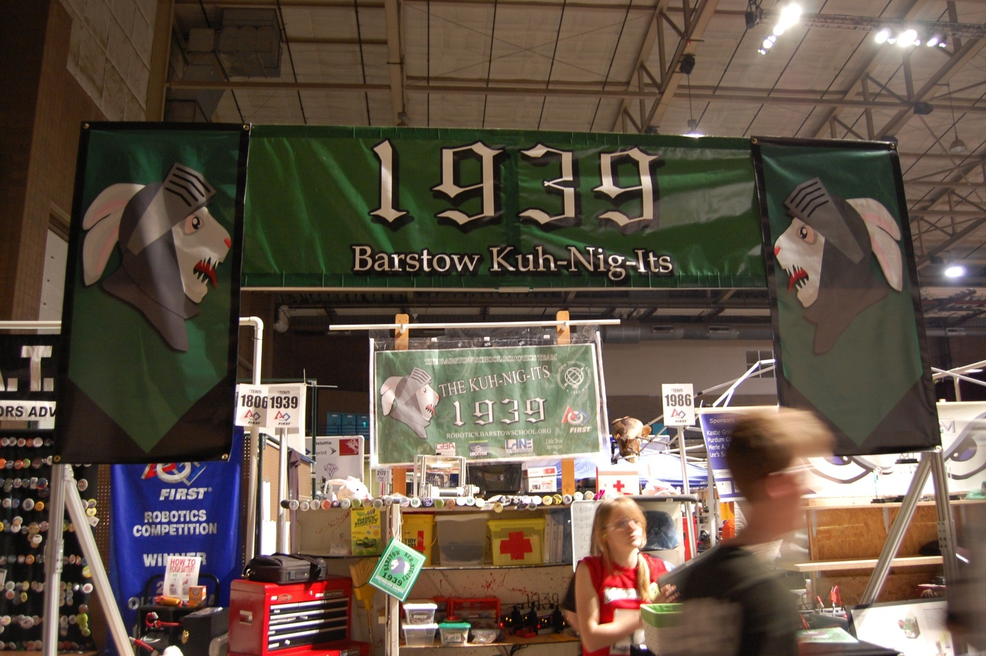
Design your pit
Bring in your theme, color and number.

Slide 33
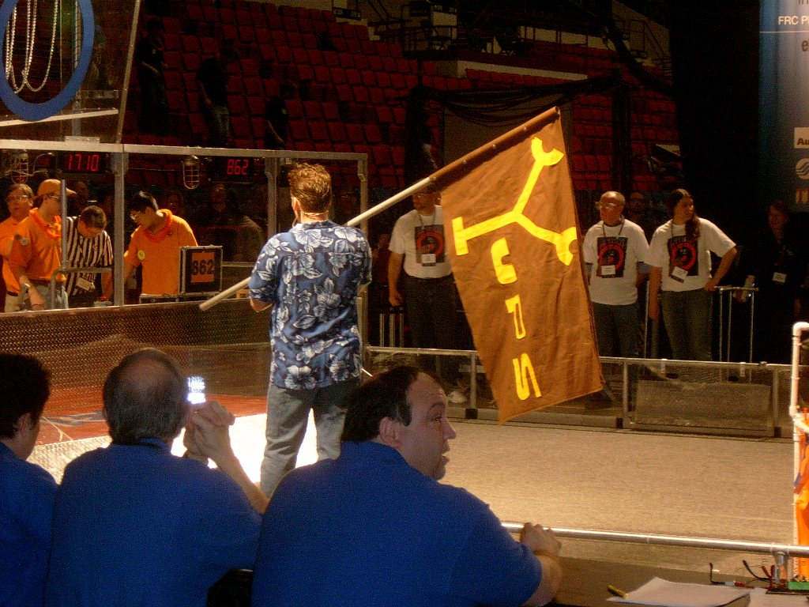
Add flags
At the beginning of a round the announcer will display flags of the competing teams. Make something visually striking.

Slide 34
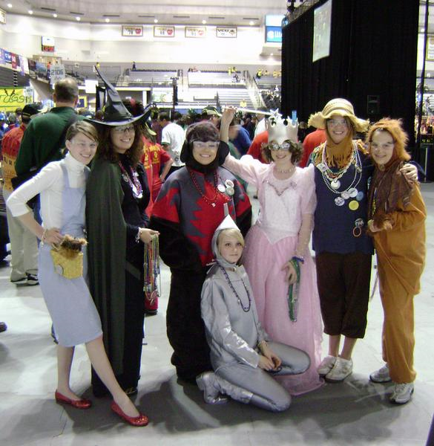
Add costumes
Maximum Oz

Slide 35
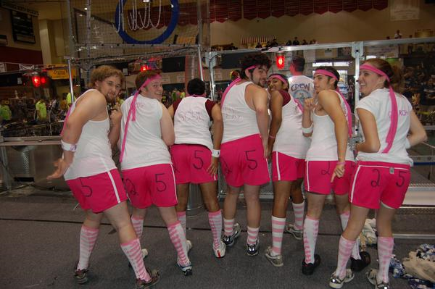
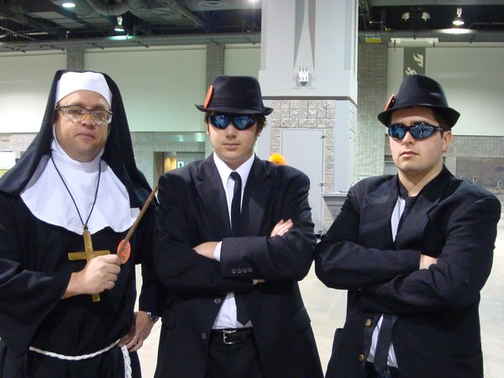
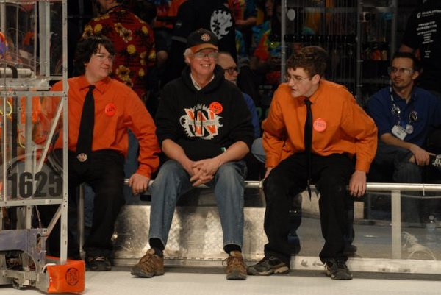
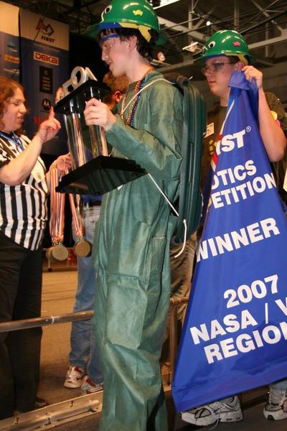
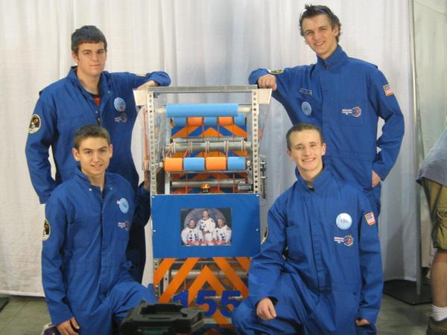
Dress up the drive team

Slide 36
Tools

Slide 37
Graphics programs
Photoshop (and someone who can use it)
Inkscape – An Open Source vector graphics editor, with capabilities similar to Illustrator, CorelDraw, or Xara X, using the W3C standard Scalable Vector Graphics (SVG) file format. Inkscape- http://www.inkscape.org/
Printmaster
Make sure you have a common file type or can convert.
Archive your graphics
Vector Magic - http://vectormagic.com/home converts jpg to scalable vector graphic

Slide 38
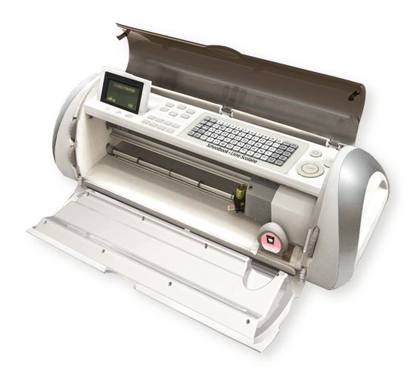
Cricut or CNC
Cricut and Sure Cuts A Lot or a CNC machine that you can cut paper,fabric and vinyl on. Sure Cuts A Lot allows you to download your custom graphics to the Cricut. Some scrapbooker at your school might have a Cricut.
Cricut: http://www.cricut.com/
Sure Cuts A lot for Cricut Machine - http://www.craftedge.com/purchase/purchase.html
Image to Cricut tutorial - http://scrappydew.com/tutorials/files/category-video-tutorial.php

Slide 39
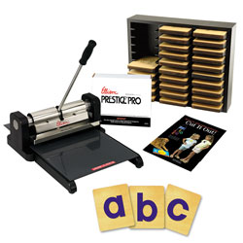
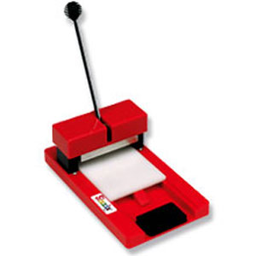
Or a Diecut machine
Your school might have one.Try the elementary school
Or a scrapbooker
Sizzix or Ellison

Slide 40
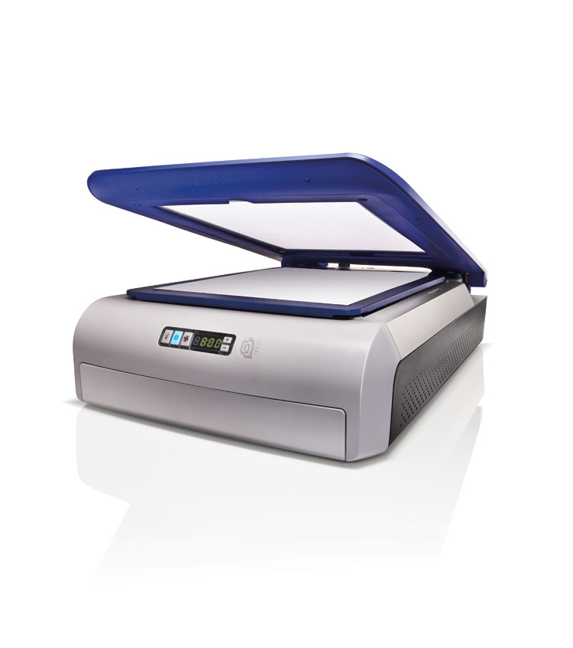
Yudu
Screenprinting
Yudu – Screen print http://www.whatdoyudu.com/
Screen Printing: Cheap, Dirty, and At Home - http://www.instructables.com/id/Screen-Printing:-Cheap,-Dirty,-and-At-Home/
Use it to make flair, t-shirts, working shirts. Buy your competition shirts from a vendor, but you could make build season shirts or personalize shirts for build season.

Slide 41
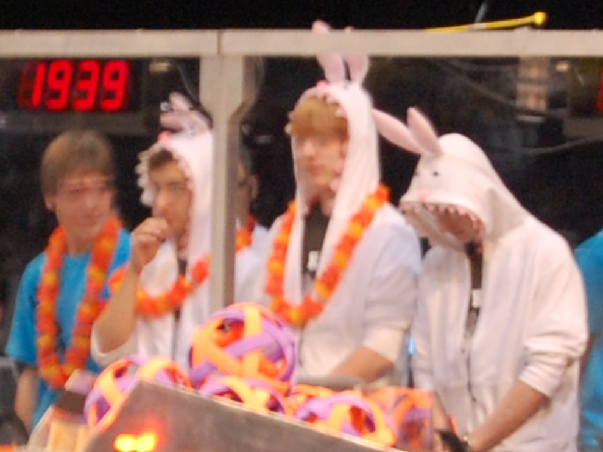
Sewing Machine
Find someone who can sew. A parent or non-builder. They can help you design costumes.
Check out patterns from the fabric store. They have a lot of costume patterns that you could adapt. They have every thing from animals to pirates and elves.

Slide 42
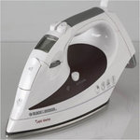
Iron
$10 -$14 cheap is fine , teflon coated nice
Good for iron ons and getting the wrinkles out of your flag that some kid stuffed into the crate last year.
The team will destroy it. Glue gets on it, iron-ons will get burned on it .

Slide 43
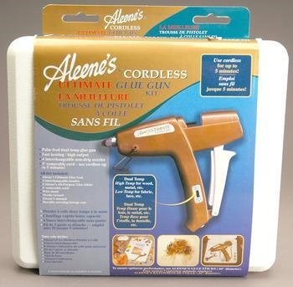
Glue Guns
Hobby Lobby has them for around $3
Get about 5 low melt
Get one nice one like Aleene’s Ultimate Glue Gun at Michaels

Slide 44
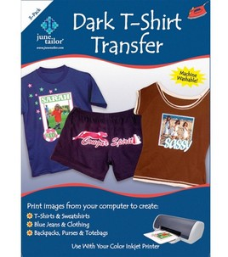
Supplies
Inkjet T-shirt Transfer
$20 / 10 sheets
$1/sheet online
Don’t wash well
Easy to use for 1 or 2 shirts for limited use
We make 2 safety captain shirts.

Slide 45
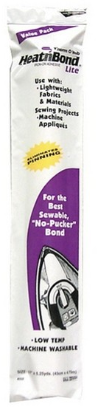
Heat’N Bond – Ultra and lite iron on adhesive
$10.99 for 17” X 5 yards
JoAnn’s & Walmart
Also can use Wonder Under
Ultra can “leak” through thinner fabrics
Use it to applique fabrics onto flags and costumes

Slide 46
Velcro
Preferably Industrial strength
Cheaper on line, but can get it in 15 yard lengths for 25-30 dollars at JoAnn’s. Use a coupon for 40% off.
Use it to hang banners, attach stuff to robot, build podiums.

Slide 47
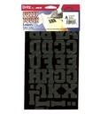
Iron on Letters and images
Use to personalize t-shirt with kid’s names.
Pretty expensive
Sizes up to 5 inches could be used for flags.
Felt Stick on letters

Slide 48
Coupons, Coupons, Coupons
Michaels, JoAnns, Hobby Lobby
Sign up for tax exempt card at all stores or have a tax exempt certificate with you at all times
Sign up for email coupons AND snail mail coupons at all stores.
Sign all team members up for coupons and collect them. 40% for one item off adds up.
Sign up for educational discount

Slide 49
Tips
Most kids don’t like to wear hats
Many kids are afraid to look silly. Train the team that it is alright.
You never come home with all the hats you made.
If it is uncomfortable or hot, it isn’t going to get worn.
Don’t use a lot of white, it gets dirty.

Slide 50
Conclusion
Spirit is marketing.
It brands your team and makes them memorable.
It gives everyone a responsibility.
Stay on message.
Push your number and logo.
Don’t be afraid to be silly.
Don’t save it just for the competitions.
Use engineering principles to design the flair/swag.
It’s all about fun.

